Slide 1
Online Courses

Slide 2
Purpose :- To build a web service through which any client/web user can get Information related to any subject (for study).
Scope :- Create different Authorized user to handle website and also maintain the information.

Slide 3
View
- Client perspective
- Administrator perspective
- Technical Support

Slide 4
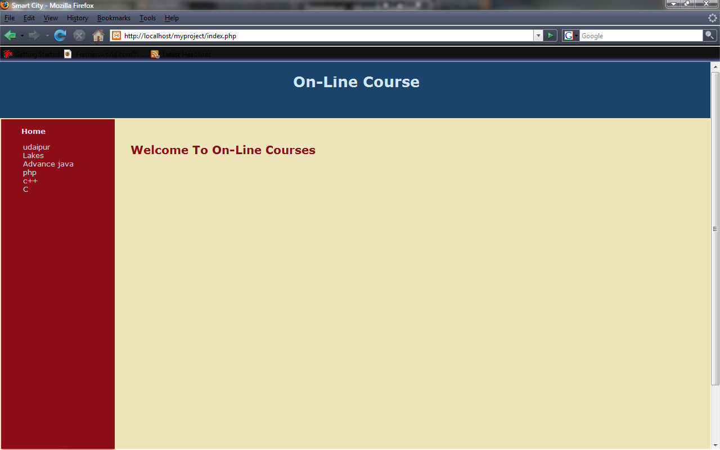
- Home page.

Slide 5
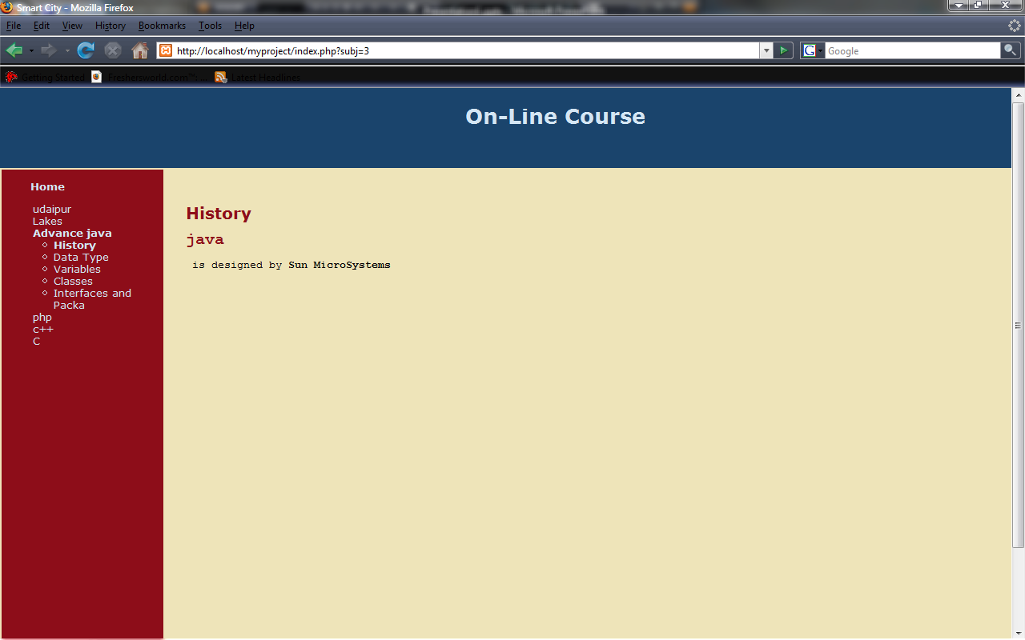
Choose any Subject.

Slide 6
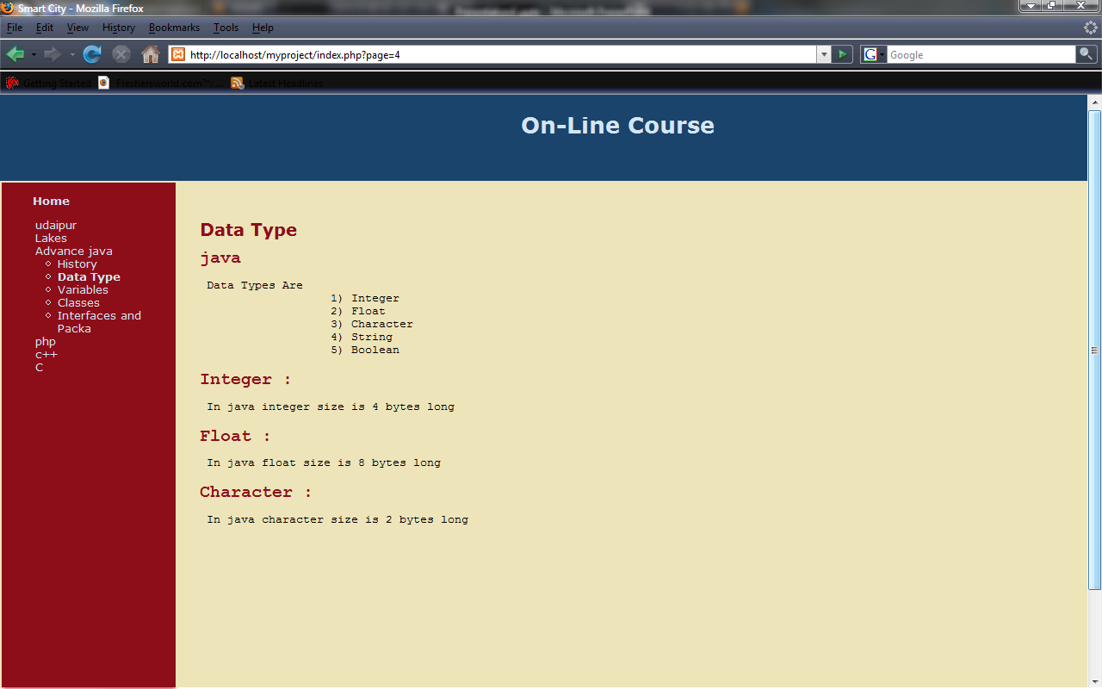
- We can choose any particular topic of any subject
back

Slide 7
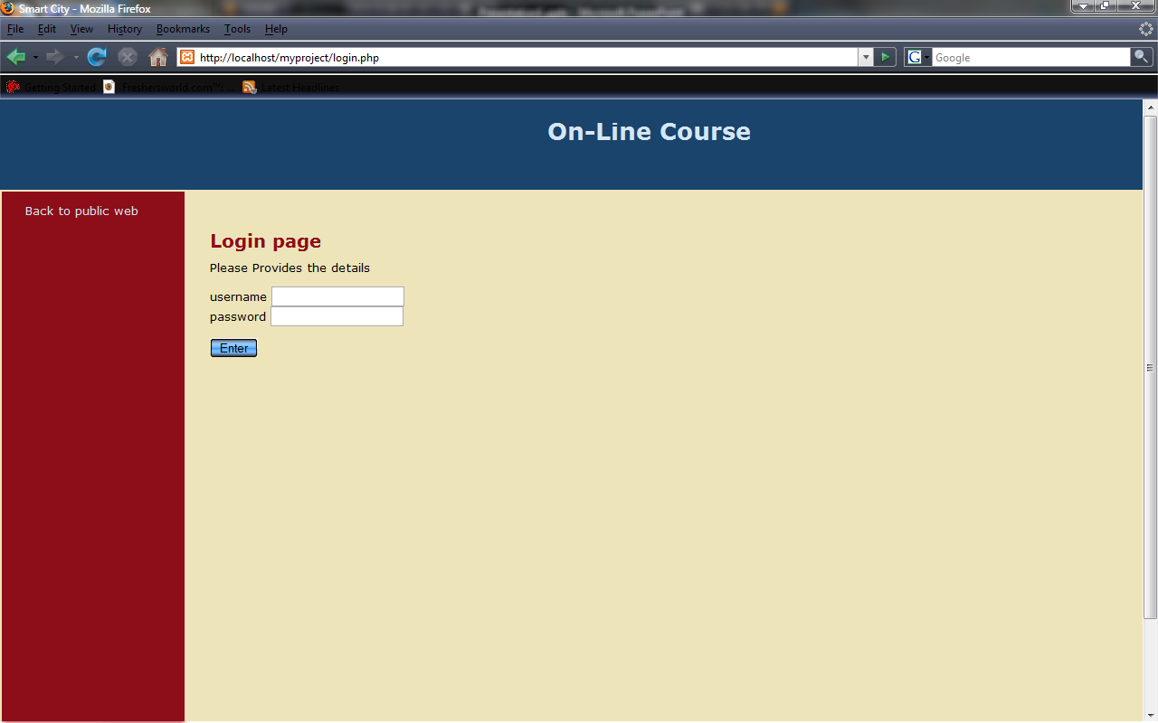
- Enter Administrator name(user name) and Password

Slide 8
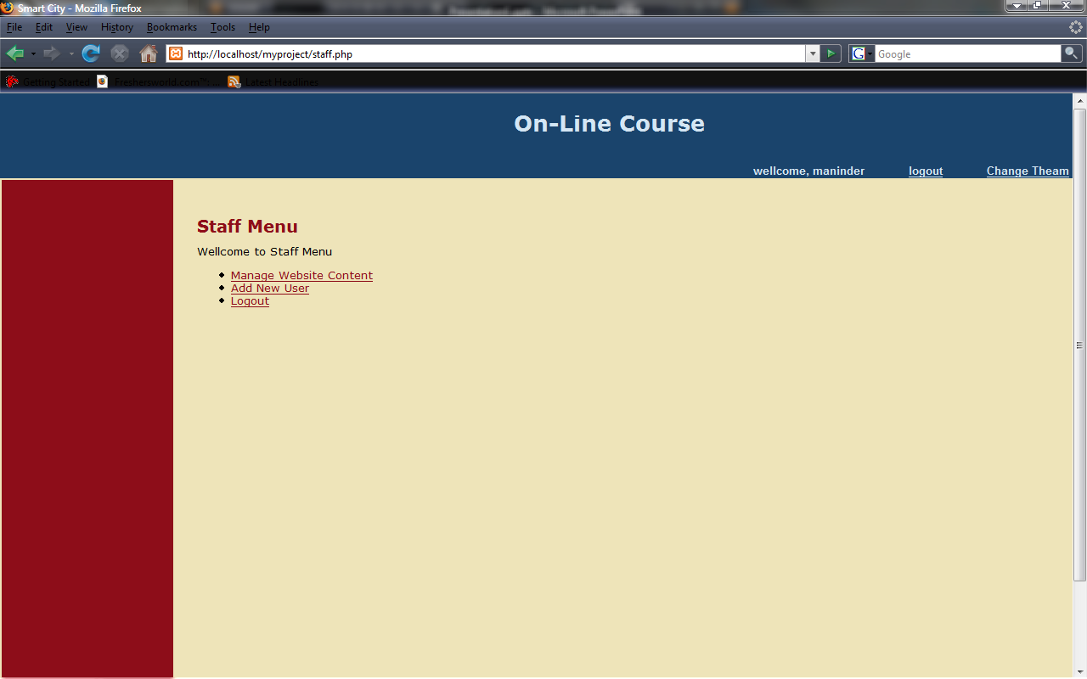
- Here we have 3 power option.

Slide 9
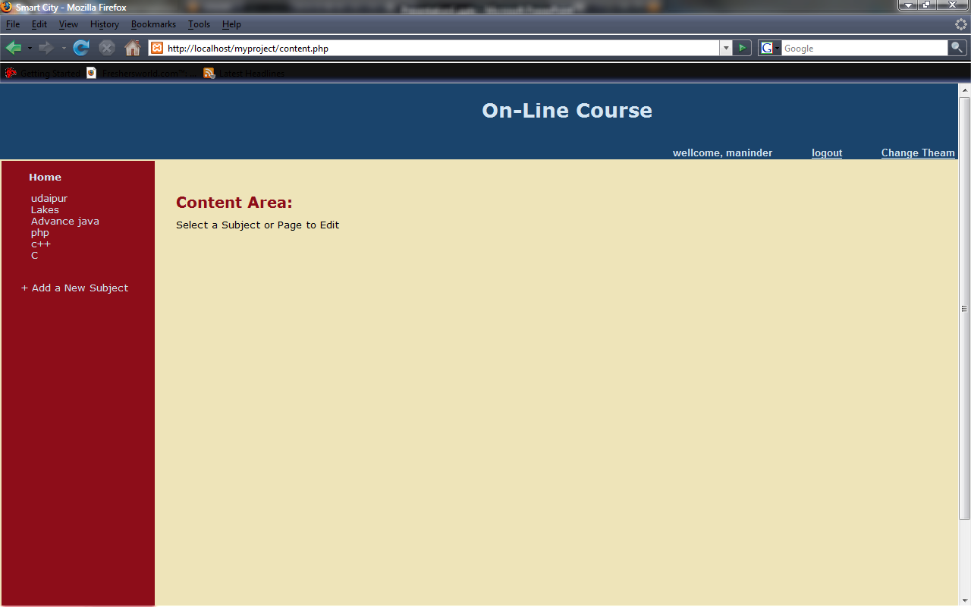
Here 2 Option
Edit Subject or Page
Add new Subject

Slide 10
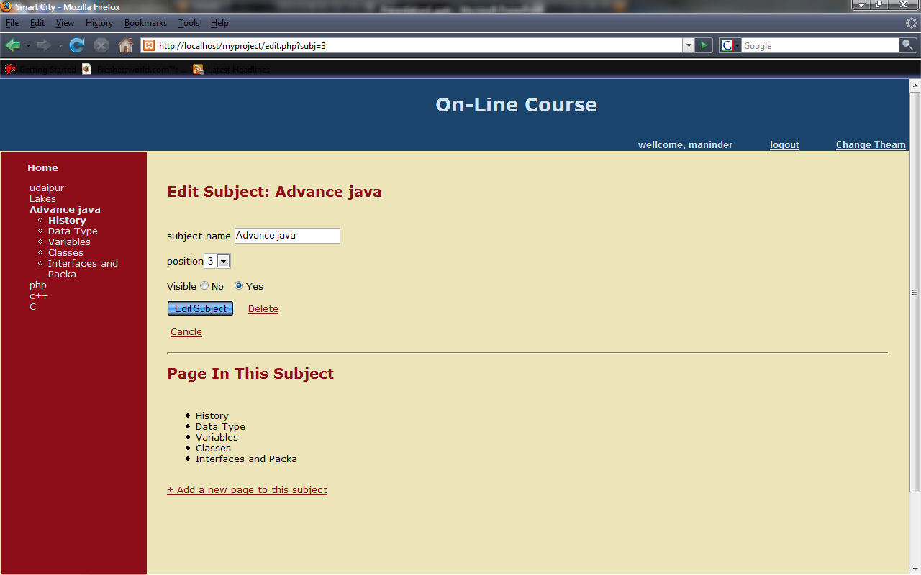
- Can change Subject Name, Position, Visibility or can Delete Subject.
- Can Add new Page.

Slide 11
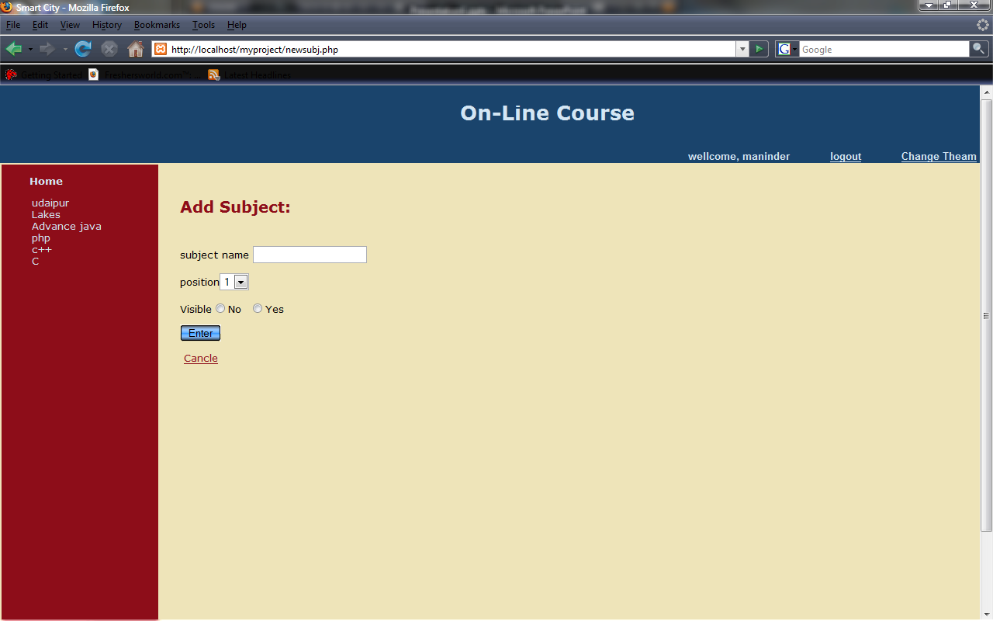
- Can Add New Subject.

Slide 12
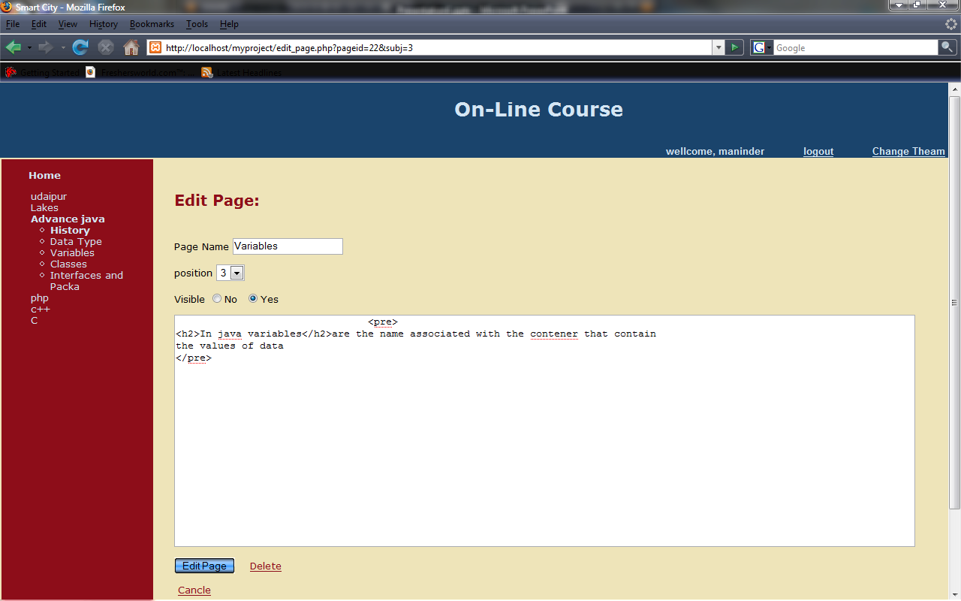
- Can Edit Page.

Slide 13
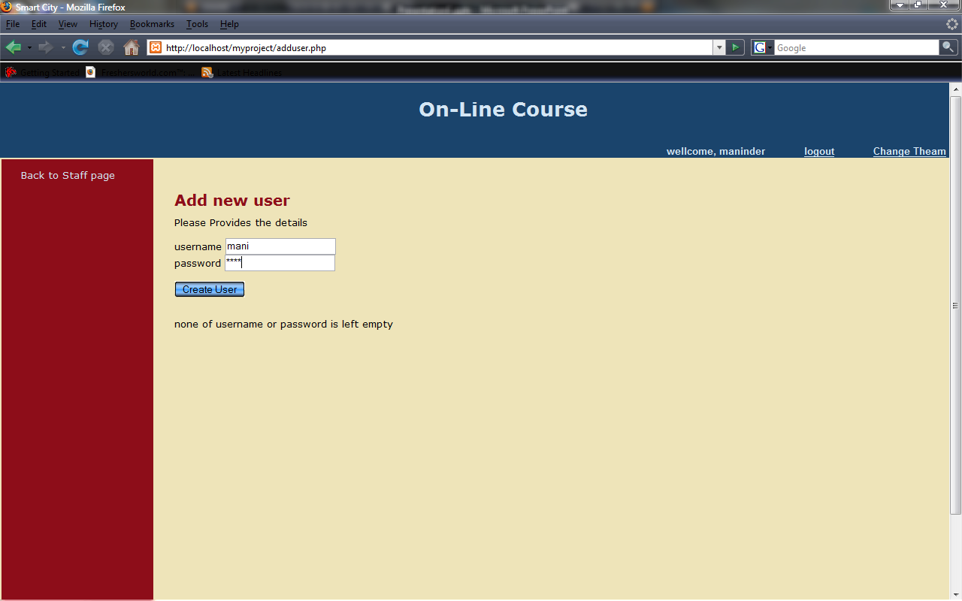
- Can Add new user.
back

Slide 14
Technologies:-
- PHP : Application Architecture
- MYSQL: Database
- APACHE: Web-Server
- Relational Database: Design Tool

Slide 15
PHP :-
- “personal home page hypertext preprocessor”.
- “server side scripting language”.
- PHP scripts are executed on server.
- open source software.
- free to download and use.

Slide 16
HTML:- - “Hypertext Markup Language”.
- used to design static web pages.
HTTP:- - “Hypertext Transfer Protocol”.
- Is a transaction oriented client/server protocol between web browser & a Web Server.
HTTPS:- - “Secure Hypertext Transfer Protocol”
- Is a HTTP over SSL (secure socket layer).
TCP/IP: - - “Transmission Control Protocol/Internet Protocol”.
- The suite of communication protocols used to connect hosts on the Internet.
- TCP/IP uses several protocols, the two main ones being TCP and IP.

Slide 17
Application | Client-side | Server-Side
Web-technology | HTML | PHP
Server | ---- | Apache
Database | ---- | MYSQL

Slide 18
Software Interface:-
Client on Intranet: Client Software, Web Browser, OS (any)
Web Server: Apache, OS (any)
Data Base Server: MYSQL, OS (any)
Development End: (PHP, HTML),OS (Windows), Apache Web Server.

Slide 19
On-Line Courses Blue-Print :-
Public web-site Staff-area
Main Web-Site
-navigation
-page content
Main Web-Site
-navigation
-page content
Login
- Username
- Password
Login
-username
-password
Menu
- Manage content
- Add-user
- Logout
Manage content
- Navigation
- Subject CRUD
- Page CRUD
Add user
- User CRUD
Logout
- Do logout
Back to login
page
* CRUD -Create Read Update Delete

Slide 20
Over All View :-
A
Administrator (Level - 1)
Web Viewer
Staff Area (Level - 2)
Delete & Add New Authorized User
Delete & Update
Web contents
Create & Read
Web contents
View Online
Web contents
A
A

Slide 21
Constraints :-
- GUI is only in English.
- Login and password is used for identification of Authorized
User .
- This system is working for single server.
- There is no maintainability of back up so availability will get
effected.
- Limited to HTTP/HTTPS.

Slide 22
Enhancment :-
- Authorization level can be more strict.
- Practice Exercise.
- Link must be provided of the other educational website so the area become wide.
- Availability of Dictionary specially for English Subject.
- Provide Video & Audio tutorials.
- Maps & Pictures; specially for Geographical Subject.

Slide 23
Thank you

